Slide 1
What makes a Podcast Popular?
By John Henry Wilson

Slide 2
Qualities of Popular Podcasts
Over 50% of the most popular podcasts have over 100 episodes
Nearly 80% of the most popular podcasts have 10 episode or more
Over 50% of the most popular podcasts did not contain explicit content
Over 60% of the most popular podcast episodes did not contain explicit content
The average duration of the most popular podcast episodes was about 72 minutes

Slide 3
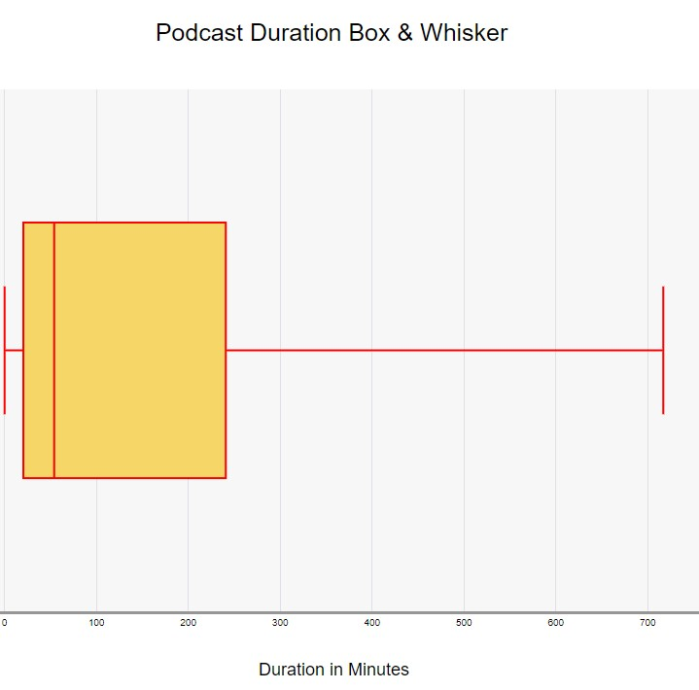
Podcast Episode Duration Stats
Median: 54.07 min
3rd Quartile: 82.31 min
Maximum: 716.94 min
Mean: 71.69 minutes
Median: 54.07 minutes
Mode: 480.8 minutes
Standard Deviation: 82.41 minutes
1st Quartile: 27.29 min
Minimum: 0.11 min

Slide 4
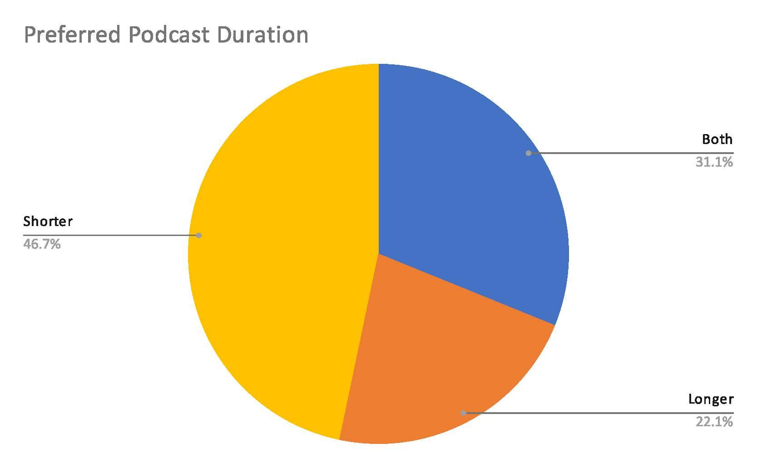
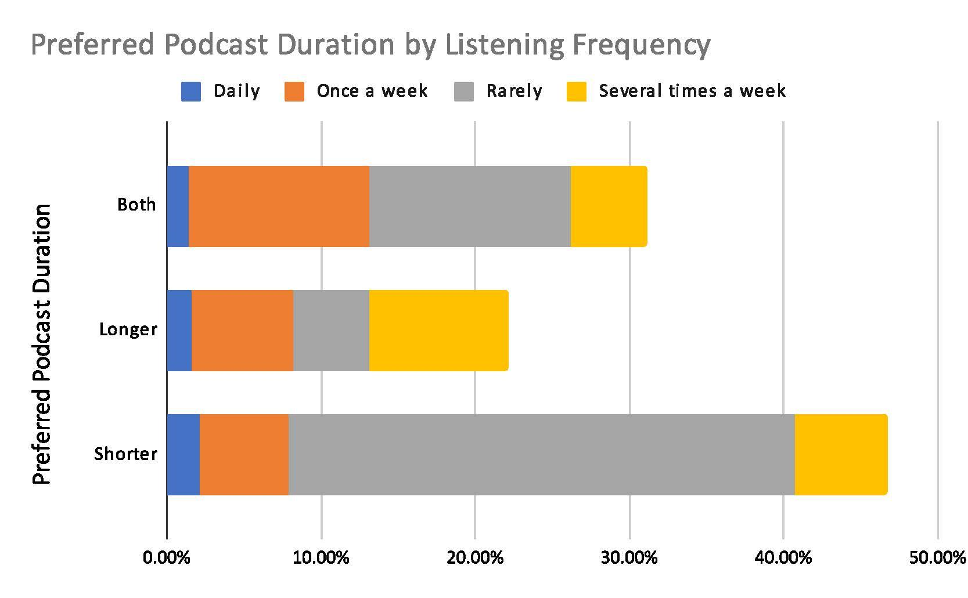
Know Your Audience - Preferred Duration

Slide 5
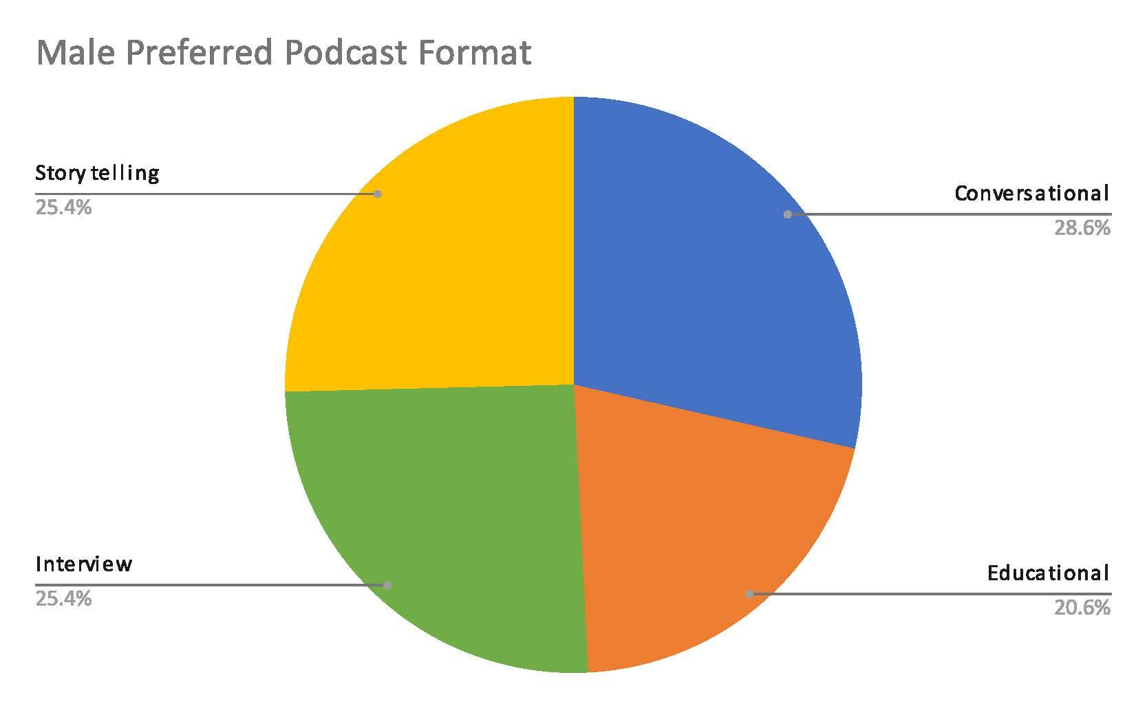
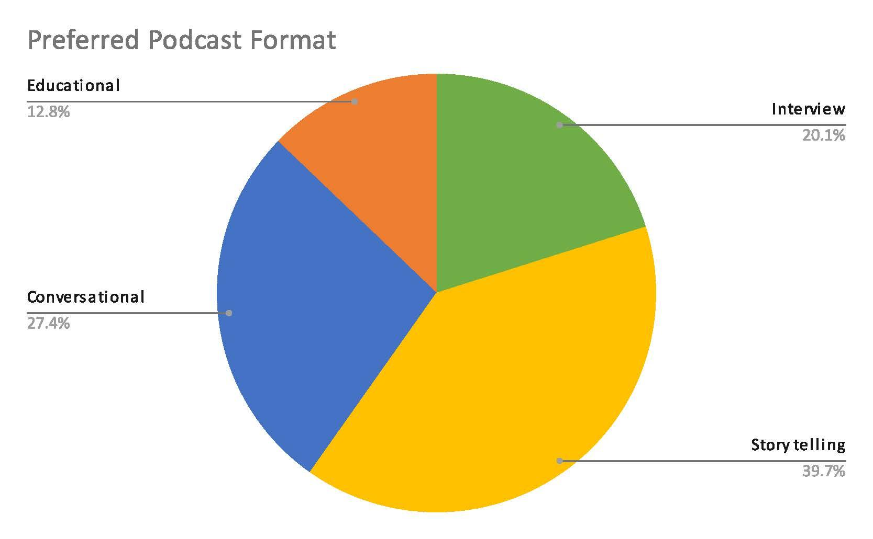
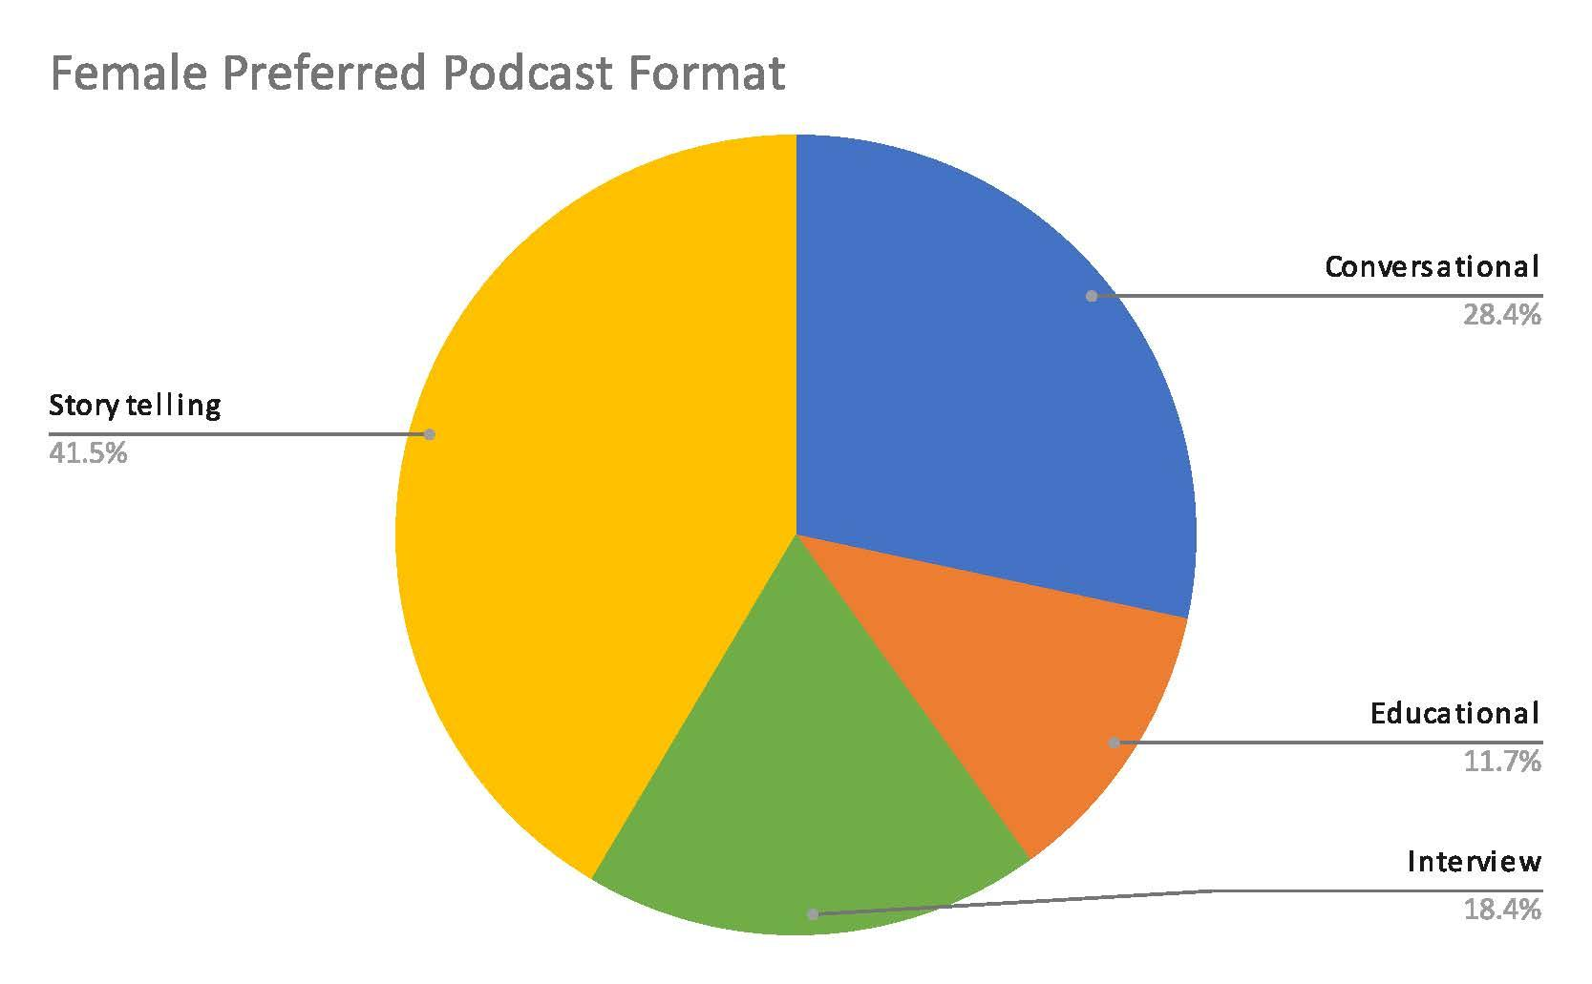
Know Your Audience - Preferred Format

Slide 6
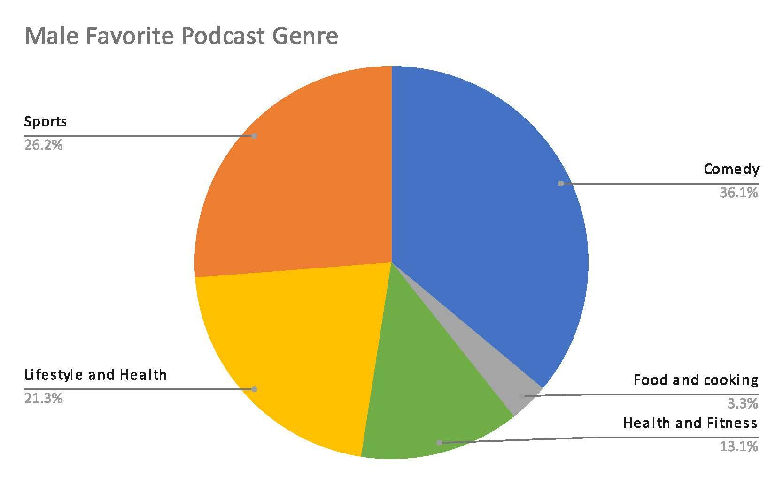
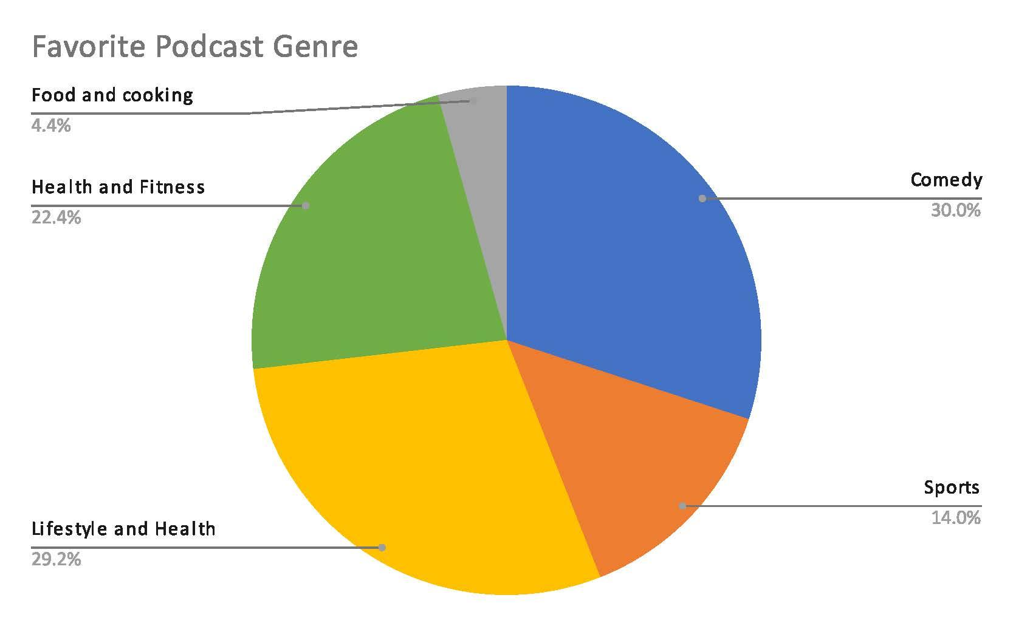
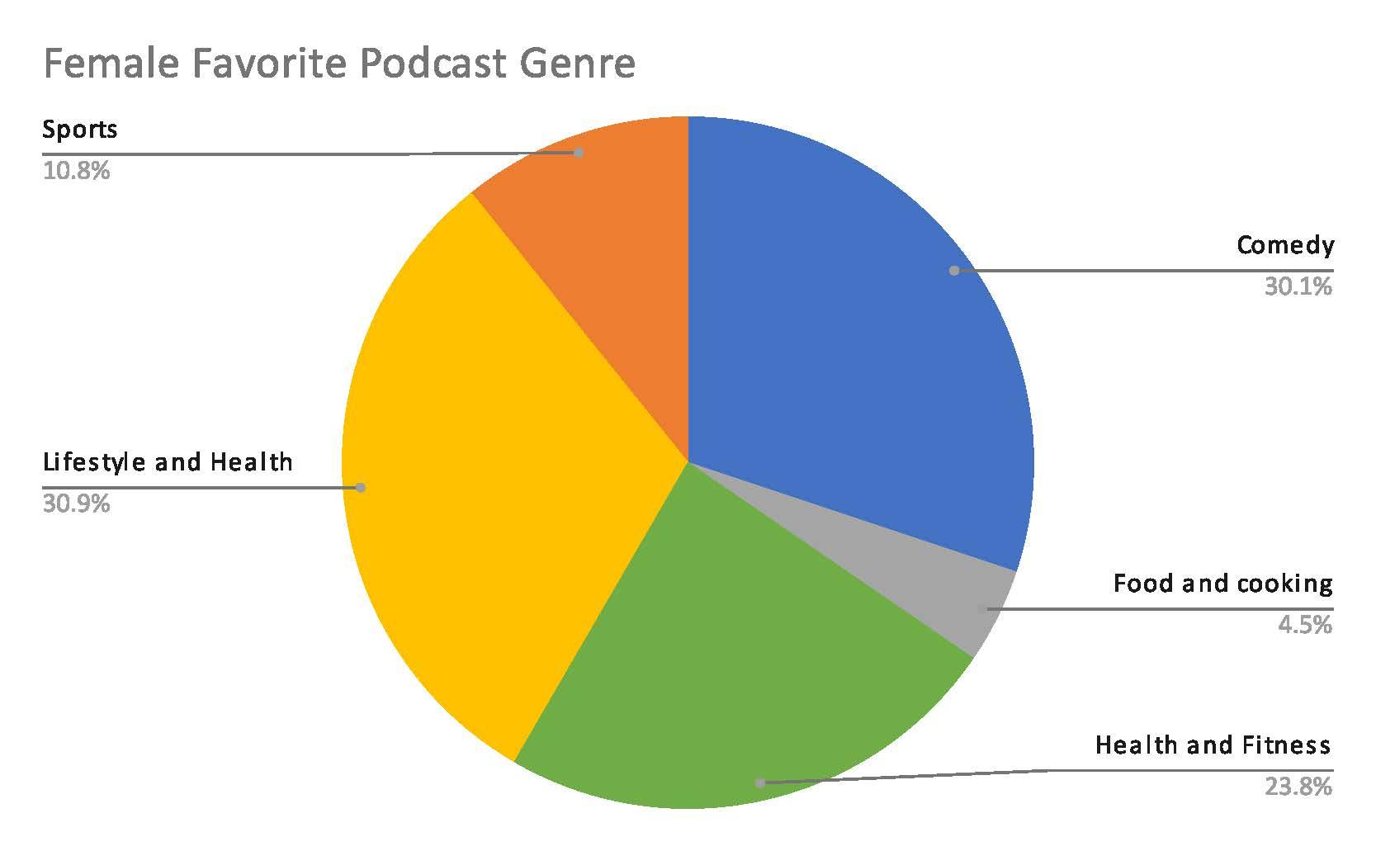
Know Your Audience - Favorite Genre

Slide 7
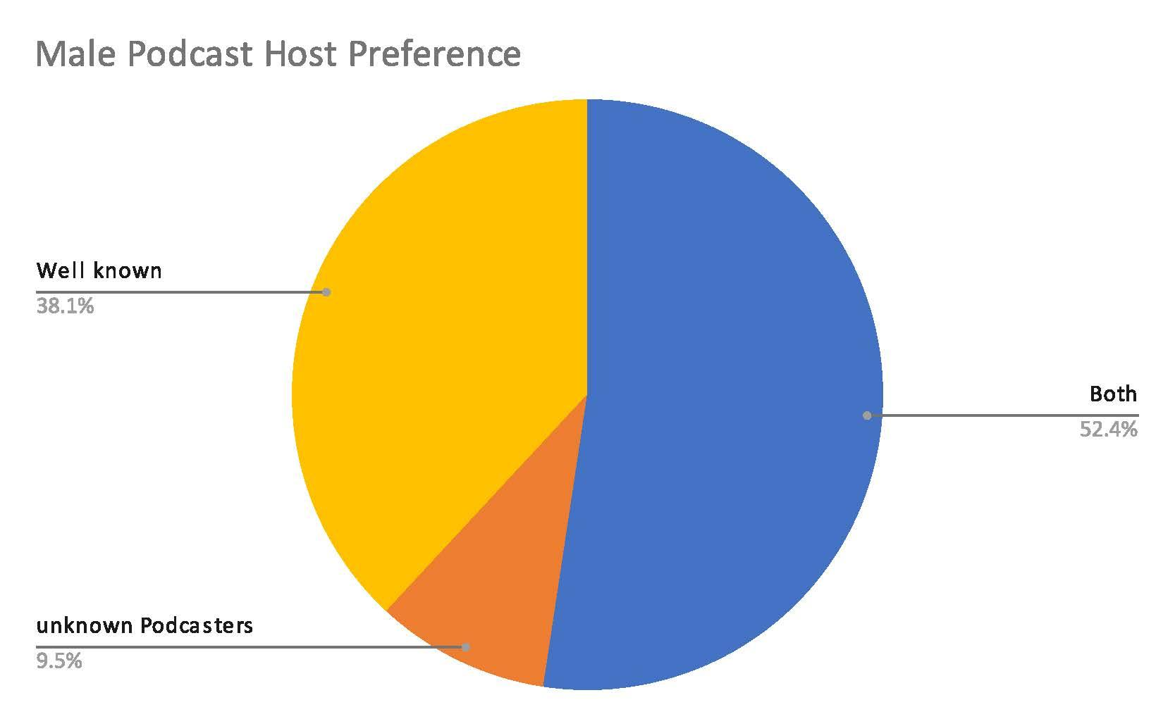
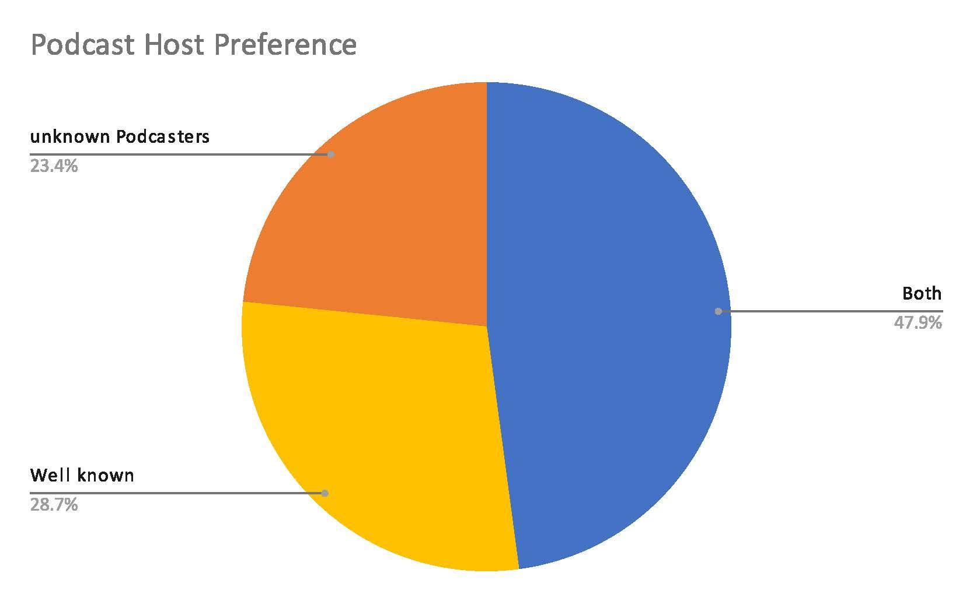
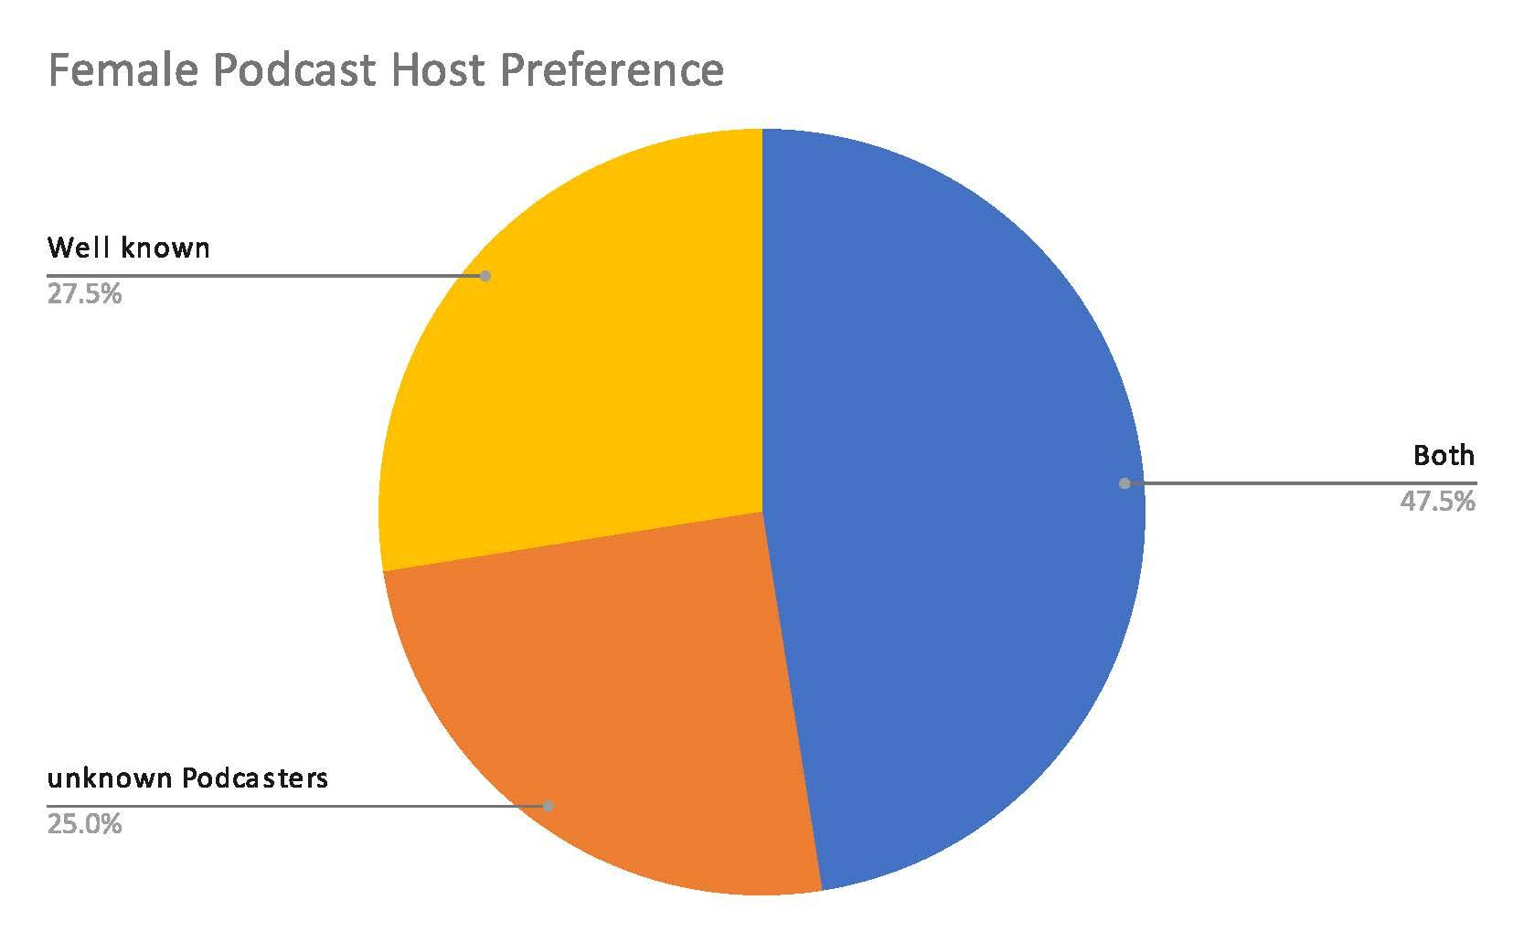
Know Your Audience - Host Preference

Slide 8
Key Insights
The ideal podcast length is about 30 - 90 minutes
A non-explicit podcast is likely to be more popular
A podcast that consistently releases numerous episodes over time is likely to be more popular
Unless your audience is viewing podcasts on a very frequent basis, shorter podcasts are likely to be more popular
Men prefer podcasts with well known hosts about sports and comedy
Women prefer podcasts with a storytelling format about health, fitness, and lifestyle

Slide 9
Data Sources
Spotify Top 100 USA Podcasts with EP
Spotify User Behavior Dataset

